Slide 1

6th Grade Math
Unit 7, Lesson 11 Multiplying Integers Using Models Volume 2, pg. 52

Slide 2


Benchmark
MA.6.NSO.4.2
Apply and extend previous understandings of operations with whole numbers to multiply and divide integers with procedural fluency.
volume 2, pg. 52

Slide 3
Integrated Mathematical Thinking and Reasoning Standards
MA.K12.MTR.2.1 Demonstrate understanding by representing problems in multiple ways.
MA.K12.MTR.3.1 Complete tasks with mathematical fluency.
volume 2, pg. 52

Slide 4

Learning Target
I can multiply integers using integer chips, number lines, and patterns.
volume 2, pg. 52

Slide 5

Warm-Up
volume 2, pg. 52

Slide 6
7.11.1 Warm-Up: Which One Doesn’t Belong?
Four number lines modeling addition are shown.
A | B
C | D
Explain which one doesn’t belong.
volume 2, pg. 52

Slide 7

Guided Instruction
volume 2, pg. 53

Slide 8

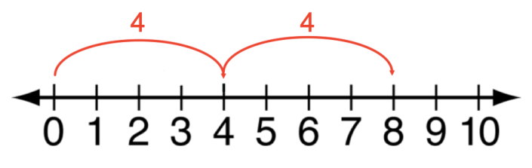
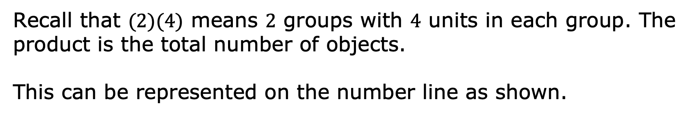
7.11.2 Guided Instruction: Multiplying Integers Using the Number Line
Recall that $(2)(4)$ means $2$ groups with $4$ units in each group. The product is the total number of objects.
This can be represented on the number line as shown.
volume 2, pg. 53

Slide 9
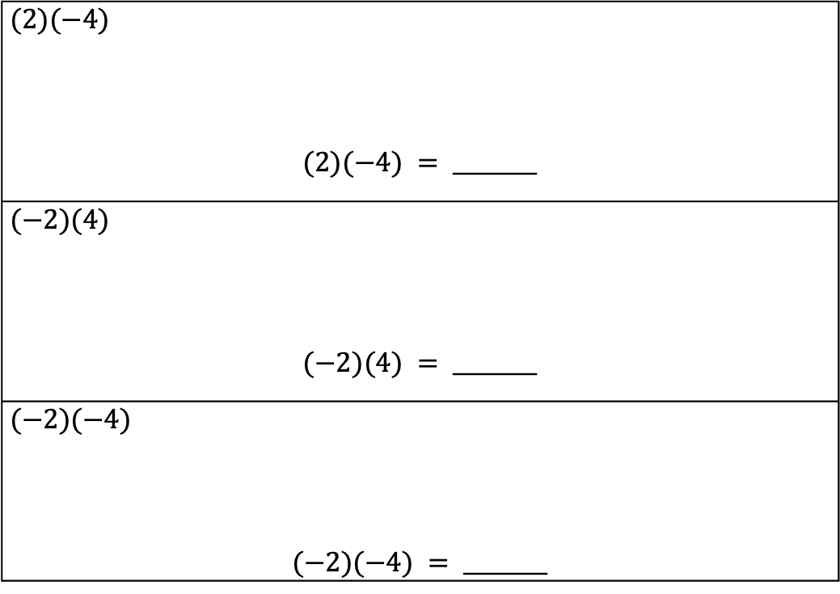
Represent each multiplication expression on the number line. Then, use it to complete the equation.
$(2)(−4)$ $$(2)(−4) = ________$$
$(−2)(4)$ $$(−2)(4) = ________$$
$(−2)(−4)$ $$(−2)(−4) = ________$$
volume 2, pg. 53

Slide 10
Verify that the rules for multiplication you created using the integer chips match the results of multiplying with the number line. Make revisions to your rules if needed.
volume 2, pg. 53

Slide 11

Guided Practice
volume 2, pg. 53

Slide 12


7.11.3 Guided Practice: Multiplying Integers Using Models
Use integer chips to model and evaluate each expression.
$(3)(−5)=$
$−2 ×−2=$
volume 2, pg. 53

Slide 13

Use a number line model to evaluate each expression.
$(8)(−1)=$
$(−4)(−4)=$
Which model for multiplication of integers do you prefer: multiplication chips or the number line?
volume 2, pg. 53

Slide 14

Your Turn
volume 2, pg. 54

Slide 15

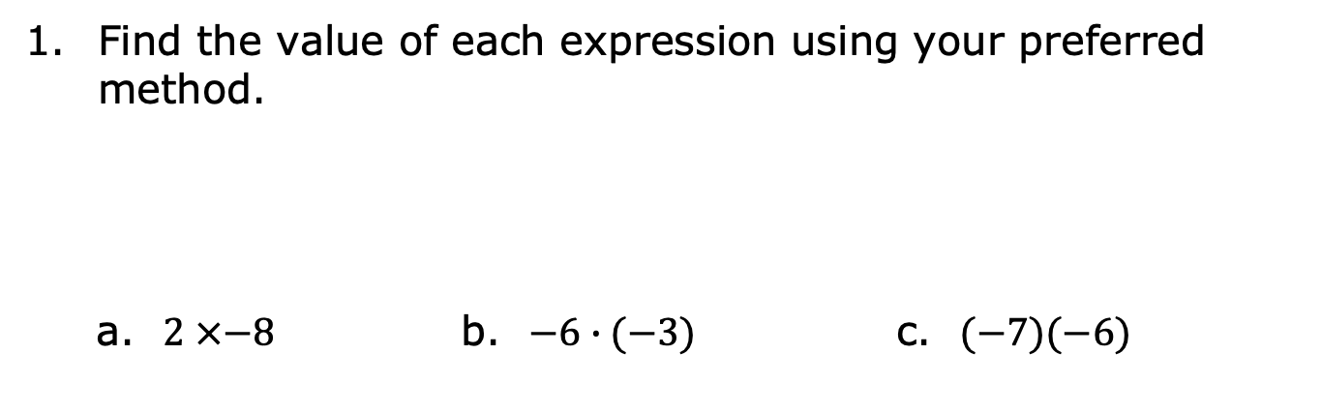
7.11.4 Your Turn!
Find the value of each expression using your preferred method.
a. $2 ×−8$ b. $−6∙(−3)$ c. $(−7)(−6)$
volume 2, pg. 54

Slide 16
d. $5(−3)$ e. $−9 ×−4$ f. $7∙5$
volume 2, pg. 54

Slide 17

Wrap-Up
volume 2, pg. 54

Slide 18
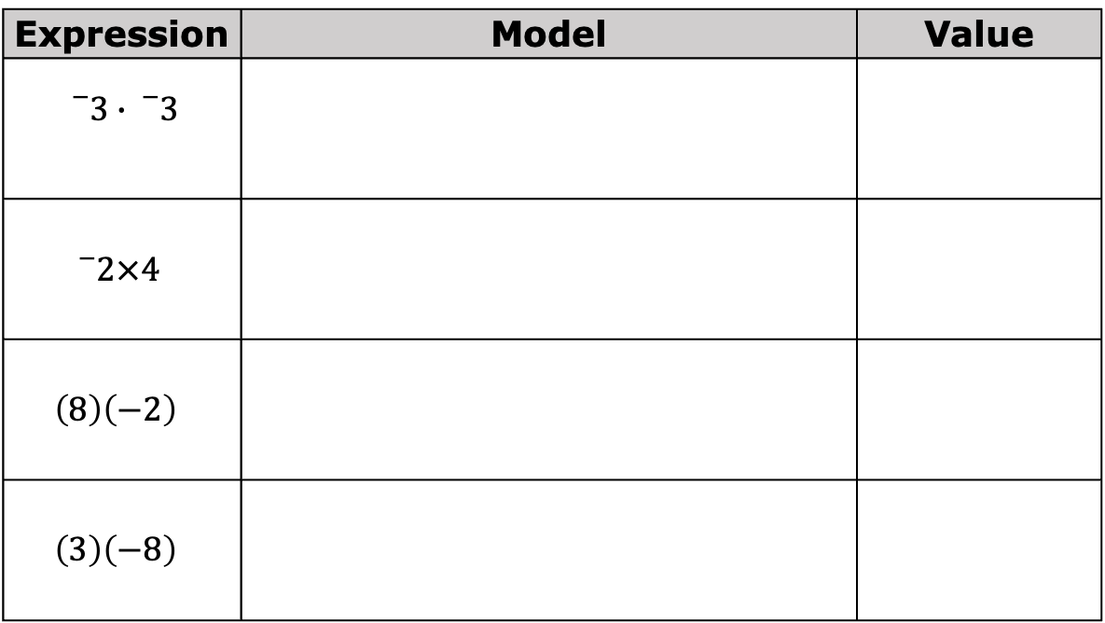
7.11.5 Wrap-Up: Ticket Out the Door
Find the value of each expression using your preferred method.
Expression | Model | Value
$${}_{}^{−}3∙{}_{}^{−}3$$
$${}_{}^{−}{2×4}$$
$$\left(8\right)\left(−2\right)$$
$$\left(3\right)\left(−8\right)$$
volume 2, pg. 54

